Slide 1

Analysis of Furniture Sales data
Presented by - Ruban Shanmugam

Slide 2
Introduction
In recent years, the furniture industry has seen significant growth, driven by trends in home improvement, increased spending on interior design, and the growing influence of e-commerce on purchasing behaviors. Understanding the dynamics within this market is crucial for businesses aiming to stay competitive. This analysis dives into key aspects of our furniture sales data, examining trends across product categories, regional preferences, customer segments, and pricing. By leveraging this data, we aim to identify opportunities to boost sales, optimize inventory, and enhance customer satisfaction.
Our primary objectives in this analysis are to:
Uncover sales patterns and high-performing product categories.
Analyze regional and seasonal trends in furniture sales.
Provide actionable insights to guide inventory and marketing strategies.
This presentation will walk you through our findings and recommendations based on these insights.

Slide 3
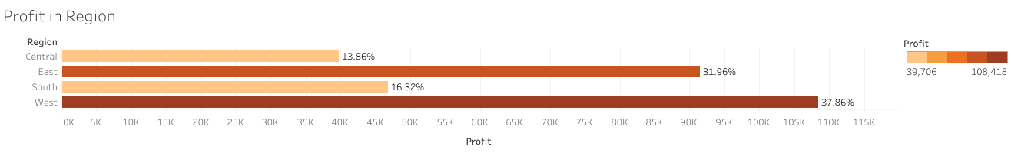
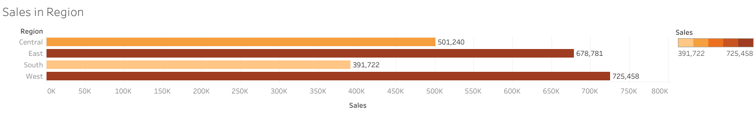
Data Analysis - Sales and profit in Region

Slide 4
Central Region: Despite sales reaching $501,240, this region has the lowest profitability, with only a 13% profit margin. This indicates potential challenges in cost management or competitive pricing pressures, suggesting the need for a review of pricing or operational efficiencies.
East Region: With sales totaling $678,781 and a solid 31% profit margin, the East region demonstrates a strong balance between sales and profitability. This region may benefit from continued investment to leverage its robust performance.
South Region: Generating $391,722 in sales and a profit margin of 16.32%, the South region shows moderate profitability. While it contributes steadily to overall revenue, further analysis might reveal areas to enhance efficiency and boost profit margins.
West Region: Leading in both sales and profitability, the West region achieved $725,458 in sales with an impressive profit margin of 37.86%. This region stands out as a key driver of profitability, indicating it as a prime area for growth and expansion.

Slide 5
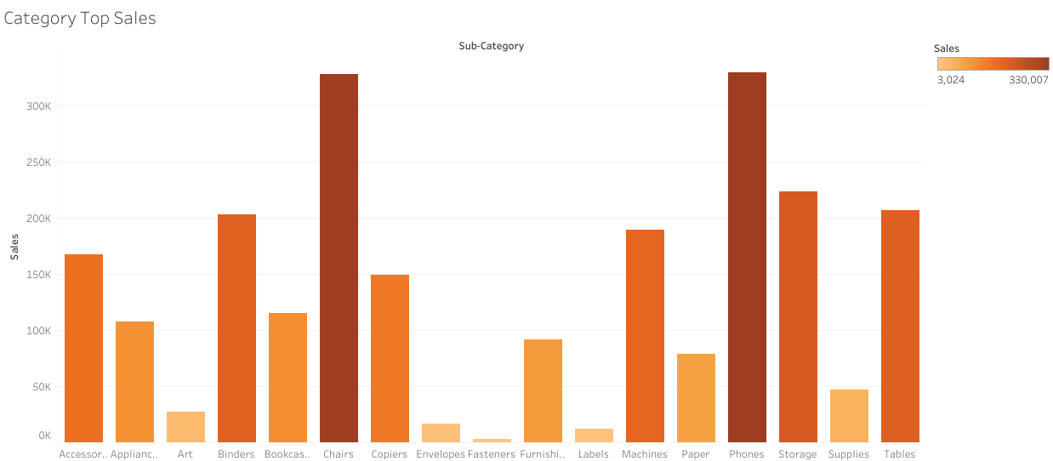
Data Analysis - Top sales on Categories
Best Selling segments: Phone and Chair
Segments with lowest sales: Labels , Envelops and Fastners

Slide 6
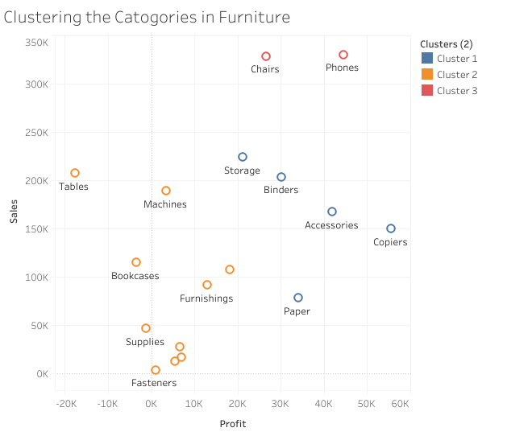
Data Analysis: Customer market segmentation
Cluster1 : (Storage , Binder.....,etc.) are the average selling in the category
Cluster2 :(Machines , tables...,etc) are the low to mediyum selling category
Cluster3 :(Chairs and Phone) are the top selling Category

Slide 7
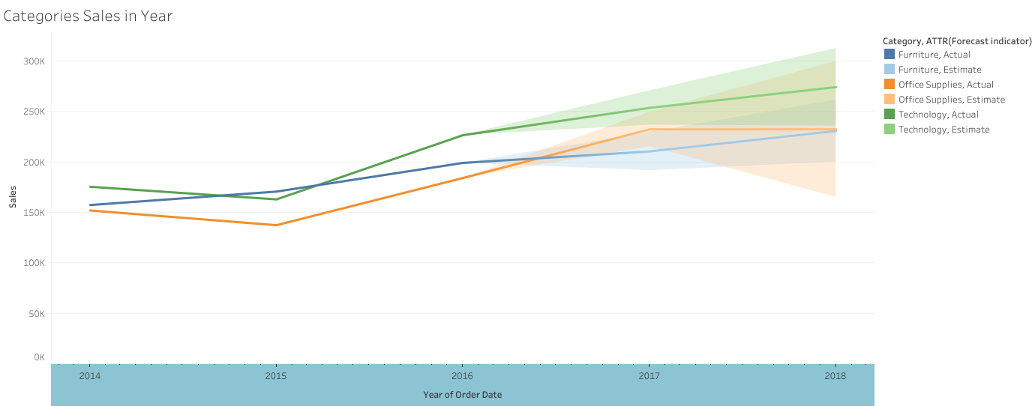
Forecast by Category using Moving Average.

Slide 8
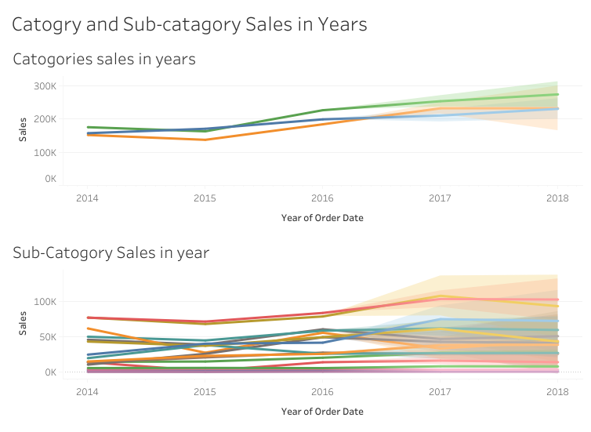
Forecast by Category and Sub-Categoryusing Moving Average.

Slide 9
Conclusion : Key insights:
Increase Operational Efficiency: Improve cost and operational efficiency in the Central and South regions to enhance profitability.
Maintain and Leverage Strength: Continue investing in the East and West regions, focusing on sustaining high performance and exploring growth opportunities.

Slide 10

Presented by : Ruban Shanmugam
Email : rubanshanmugam02@gmail.com

